Slide 1
Open Transporte
Interledger Student Hackathon 2025

Slide 2
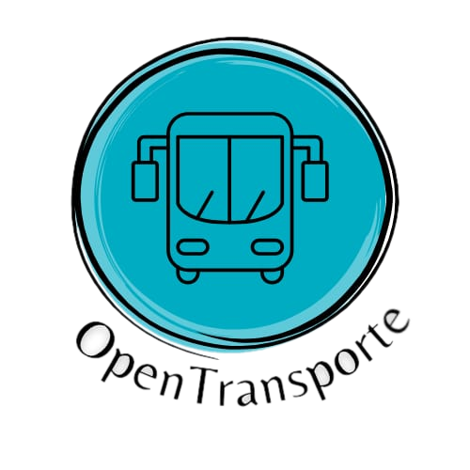
Meet the team
Open Transporte
Angel Uriel Ramirez de la Cruz
Neydi Michell Marin Torres
Moises Hernandez Lazaro
Daniel Mondragon Tapia

Slide 3
Problem statement
No transparency in transport subsidies.
Uncontrolled access creates safety risks.
Closed and fragmented system limited to cash and banks.
No real-time data on routes and usage.

Slide 4
Solution
The application is based on interoperability and Open Payments for recording public transportation usage statistics. It aims to serve as a governmental and collective tool.
Real-time payments without the need for balances.
Interoperability between transportation systems (metro, metrobús, RTP, trolebus, train, etc.).
Social programs that are directly applied to the user.
Analysis of statistics to adjust transportation supply according to demand.

Slide 5
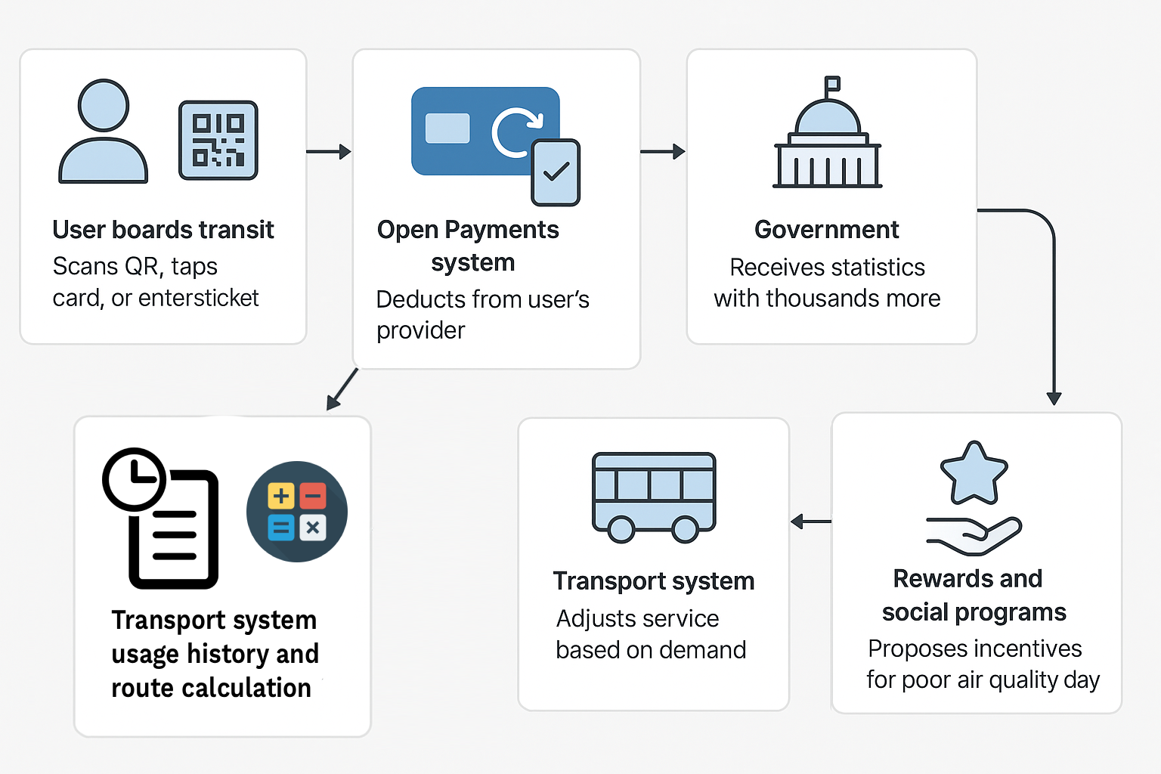
Solution

Slide 6
Demo
{Showcase a demo of your project [max 2 min]
Tip: pre-record it in case of technical difficulties on stage BUT live demo is preferred}

Slide 7
Conclusion
{Summarise and share what you would like to do next }

